Slide 1
Responsible AI Course: Emerging Trends in IT Advisor: Brad Olsen Date: 12/10/2025

Slide 2
Project Statement
Project showcases evidence of the environmental impacts of AI and recommended solutions

Slide 3
Purpose
To influence people to be more mindful when using AI

Slide 4

How Does AI Impact the environment?
Energy Consumption
Water Consumption
Co2 Emissions

Slide 5

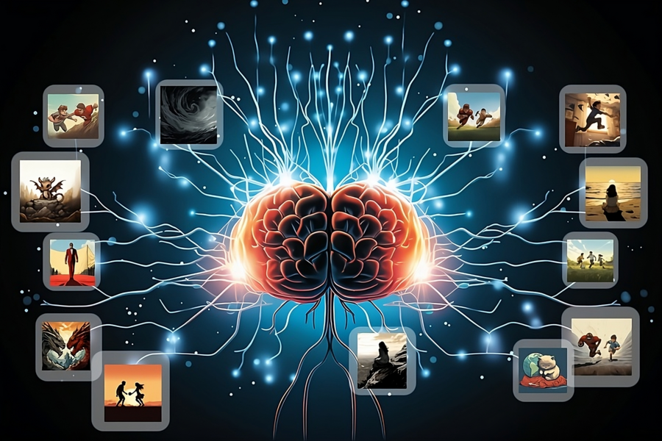
Energy Consumption
AI processes require more energy
AI processors (GPU’s) are much more complex
Require more memory storage
Training AI Models puts a massive load on these processors

Slide 6
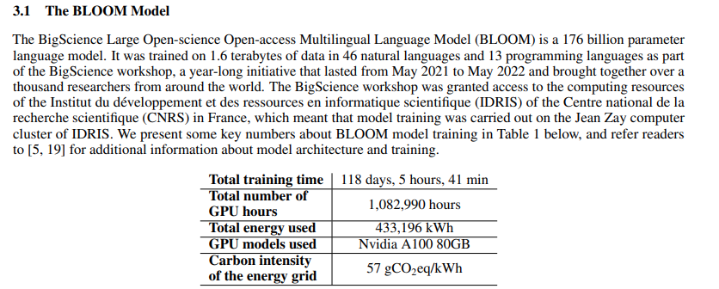
Energy Consumption
AI processes require more energy
(Luccioni et al., 2022)

Slide 7
Energy Consumption
AI processes require more energy
2018, combined U.S. data center consumption estimated to be 76 TWh, 1.9% of total U.S. energy consumption (Shehabi et al., 2024)
2023, combined U.S. data center consumption estimated to be 176 TWh, 4.4% of total U.S. energy consumption (Shehabi et al., 2024)
Efficiency is not growing at the same rate as demand. (Shehabi et al., 2024).
July 2025, ChatGPT receives an average of 18 billion messages a week, 2.57 billion a day (Chatterji et al., 2025)
The median Gemini prompt wastes 6 times more than a traditional google search.
Gemini Prompt = 0.24 Wh (Amin Vahdat & Jeff Dean, 2025), Google search = 0.04 Wh (Vanderbauwhede, 2025)
Video Generation consumes roughly 2,000 time more energy than text generation (Luccioni et al., 2023)
Notes:
“During the early and mid-2010s, a shift from on-premise data centers to colocation or cloud facilities helped enable efficiency improvements that allowed data center electricity use to remain nearly constant at a time when the data center industry grew significantly, with a large expansion of data center services.” (Shehabi et al., 2024)
In a study where the average cost of text generation was 0.047 Wh, the average cost of a single short video was nearly 90 Wh making it 1,915 times more costly

Slide 8

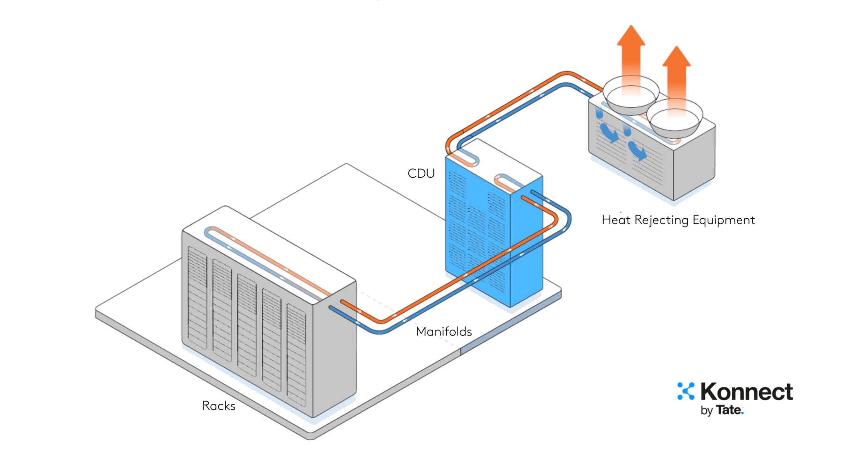
Water Consumption
Data centers consume water for cooling
2014, U.S. data centers consumed 21 billion liters of water (Shehabi et al., 2024)
2023, U.S. data centers consumed 66 billion liters of water (Shehabi et al., 2024)
Notes:
Packed super computers create lots of heat
Water tubes touch the computers
Heat transfers from computer to tube water
Water is cooled back down evaporating in the process

Slide 9
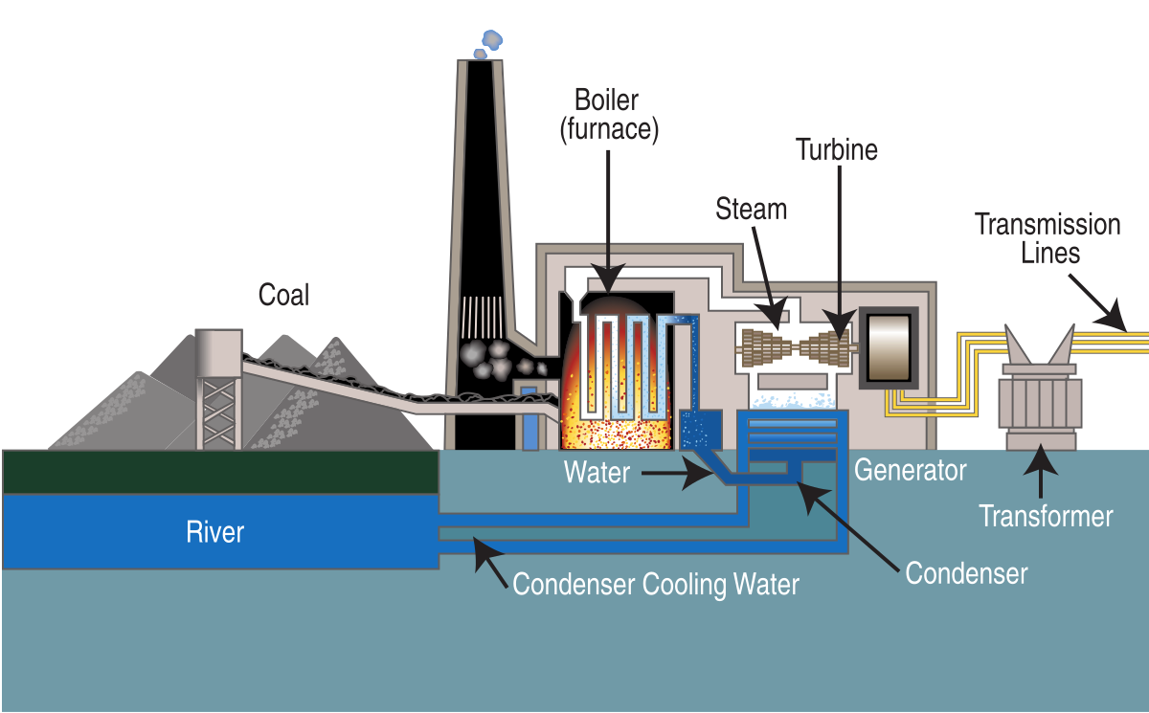
Indirect Consumption
Power plants consume water and burn fossil fuels to provide electricity
*Based on the 176 TWh consumed in 2023
2023, total indirect water footprint 800 billion liters of water
2023, total indirect GHG footprint 61 billion kilograms of Co2 (Shehabi et al., 2024)
Notes:
Water comes from fresh water sources
Water is evaporated into steam
Steam makes turbines spin
Turbine motion is turned into electricity sent to data center.

Slide 10

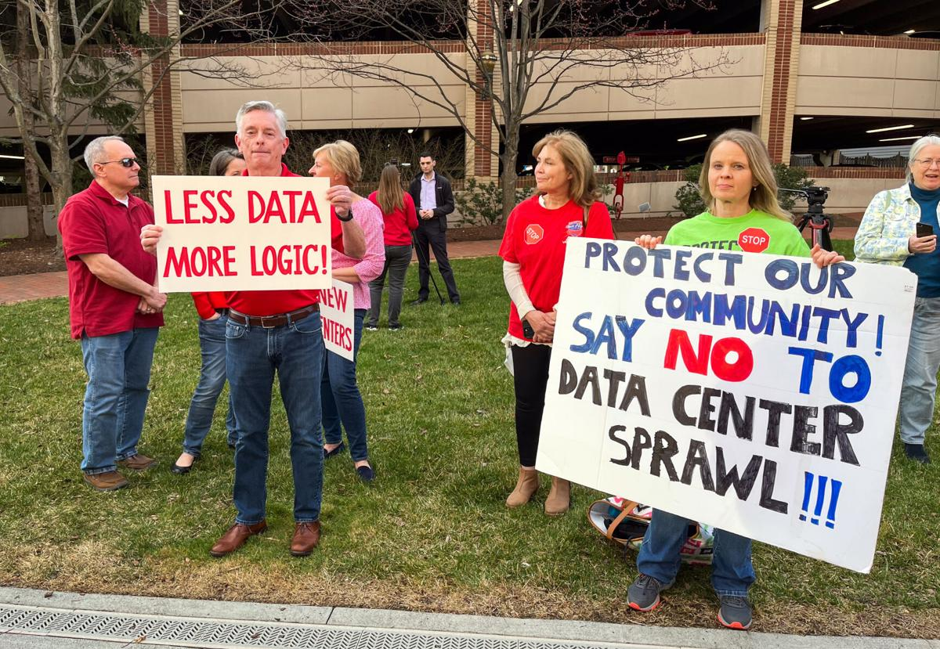
Solutions / Mitigation
Reduce demand
Get involved

Slide 11


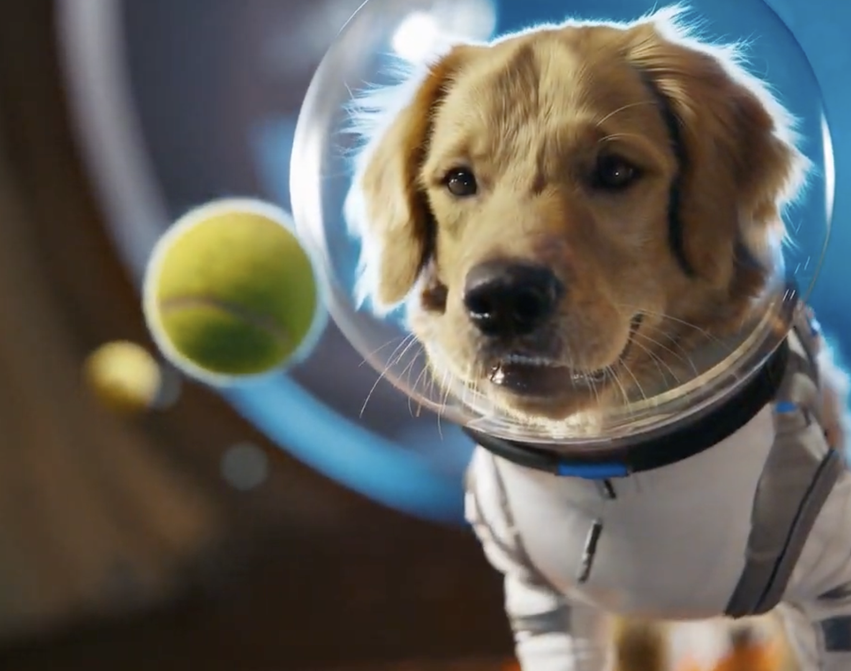

Solutions / Mitigation
Reducing Demand
Limit use of video models like Veo and Sora
Find and re-use old search prompts for answers instead of re-prompting the model
Use non-AI search engines
Use models locally whenever possible

Slide 12
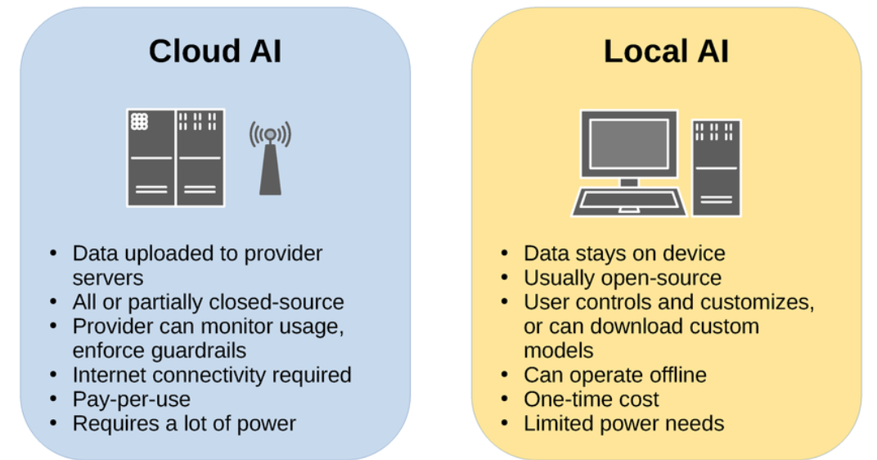
Solutions / Mitigation
Reducing Demand

Slide 13



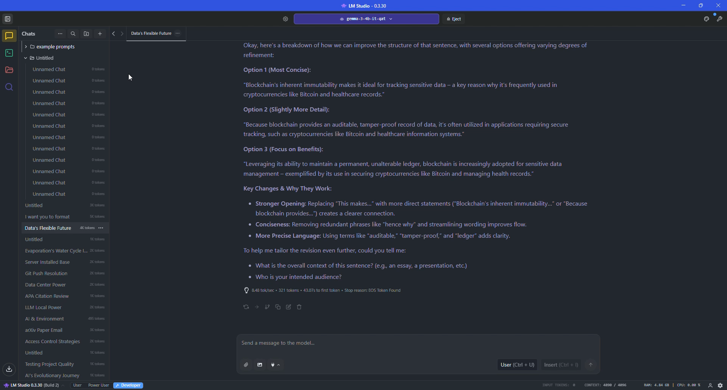

Reducing Demand
z
Using AI Models locally

Slide 14
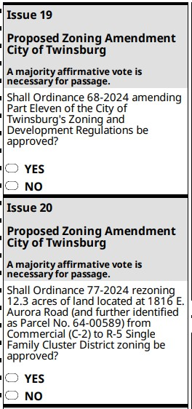

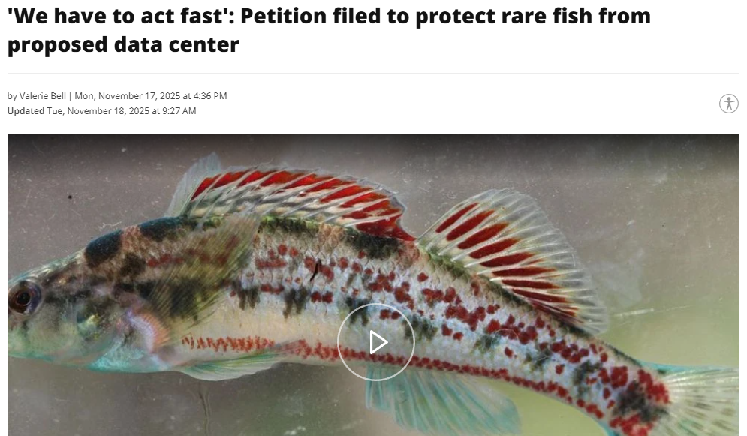
Reducing Demand
z
Get Involved
Vote for propositions and ballot initiatives that protect the environment and local communities
Vote for city council members that place the environment first
Stay aware of current events regarding data center developments
Join petitions or protests that help spread awareness
July 02, 2025
Nov 19, 2025

Slide 15
Course Skills Used:
Evaluate the advantages and drawbacks of selected trends.
Analyze the viability and impact of emerging technologies on the existing information systems and/or infrastructure.
Identify future opportunities for information technology solutions.
Conducting thorough research, assessing misinformation, and APA formatting.

Slide 16

Personal Links:
Link to resource center (contains additional research, tutorials, and more): https://github.com/FelipeRestrepo101/ResponsibleAI

Slide 17
Future Work:
Improving the repository
Making a tutorial video
Creating a monthly newsletter of legal cases and local events
Adding more local AI model suggestions

Slide 18
References
Amin Vahdat, A., & Jeff Dean, J. (2025, August 21). How much energy does Google’s AI use? We did the math. Google Cloud Blog. https://cloud.google.com/blog/products/infrastructure/measuring-the-environmental-impact-of-ai-inference/
Chatterji, A., Cunningham, T., Deming, D., Hitzig, Z., Ong, C., Shan, C., & Wadman, K. (2025, September). How people use chatgpt. NBER. http://www.nber.org/papers/w34255
Chow, A. R. (2025, August 13). Inside Memphis’ battle against Elon Musk’s Xai Data Center. Time. https://time.com/7308925/elon-musk-memphis-ai-data-center/
Delavande, J., Pierrard, R., & Luccioni, S. (2025, September 23). Video killed the energy budget: Characterizing the latency and power regimes of open text-to-video models. arXiv.org. https://doi.org/10.48550/arXiv.2509.19222
EPRI. (2024, May 28). Powering Intelligence: Analyzing Artificial Intelligence and Data Center Energy Consumption. EPRI. https://www.epri.com/research/products/3002028905
Hölzle, U. (2009, January 11). Powering a google search. Official Google Blog. https://googleblog.blogspot.com/2009/01/powering-google-search.html

Slide 19
Luccioni, A. S., Viguier, S., & Ligozat, A.-L. (2022, November 3). Estimating the carbon footprint of bloom, a 176B parameter language model. arXiv.org. https://arxiv.org/abs/2211.02001
Offutt, M. C., & Zhu, L. (2025, August 26). Data Centers and their energy consumption: Frequently asked questions. congress.gov. https://www.congress.gov/crs-product/R48646
Petersen, M. (2024, August 12). Power-hungry AI data centers are raising electric bills and blackout risk. Los Angeles Times. https://www.latimes.com/environment/story/2024-08-12/california-data-centers-could-derail-clean-energy-goals
Shehabi, A., Newkirk, A., Smith, S., Hubbard, A., Lei, N., Siddik, M., et al. (2024). 2024 United States Data Center Energy Usage Report. Lawrence Shehabi et al., 2024 National Laboratory. Retrieved from https://doi.org/10.71468/P1WC7Q
Vanderbauwhede, W. (2025, January 6). Estimating the increase in emissions caused by AI-augmented search. arXiv.org. https://doi.org/10.48550/arXiv.2407.16894
Yañez-Barnuevo, M. (2025, June 25). Data Centers and water consumption. Environmental and Energy Study Institute (EESI). https://www.eesi.org/articles/view/data-centers-and-water-consumption

